Slide 1
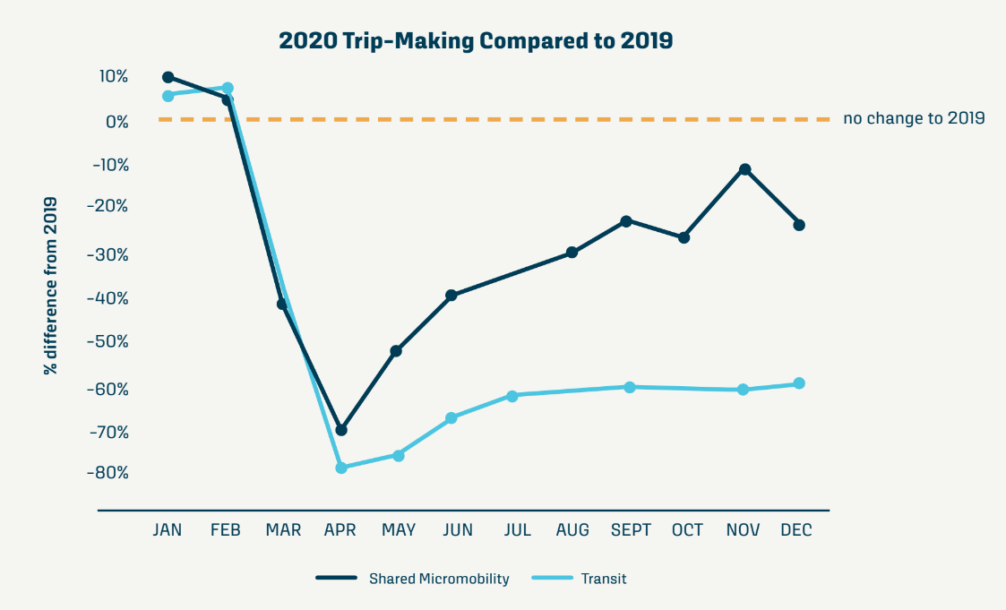
How Has Micromobility Fared During the Pandemic?
There was no mass collapse of the industry.
Shared micromobility trips initially fell similar to transit but rebounded much quicker.
51
51 fewer US cities had shared micromobility operations in 2020 compared to 2019.
-23%
In 2020, bike share ridership saw a 23% drop, compared to a 65% drop for scooter share.
+35%
In 2021, some bike share systems have reported huge growth, including in Boston, Chicago and New York. In Chicago, many months saw 30-35% growth over 2019 levels.
Source: NABSA
Notes:
Micromobility took a hit, but fared reasonably well during the pandemic.
A handful of operators went out of business, and reorganization and re-valuations occurred, but no mass collapse of the industry. That said, 51 fewer cities had shared micromobility operations in 2020 vs. 2019.
Shared micromobility trips fell initially at a rate similar to transit but rebounded much quicker.
E-scooters took a much larger hit. (65% vs. 23%)
Bike share is booming bigger than ever in 2021 in some cities.
Long-term – hard to know exactly, but it seems like micromobility is here to stay in some form. However, need to look at the TNC/ridehail example – are micromobility prices currently being subsidized by venture capital? If prices increase, will micromobility retain its popularity?
I think there will be some continued consolidation but it will stabilize in some form, especially if cities increasingly treat it as part of their transit system.

Slide 2
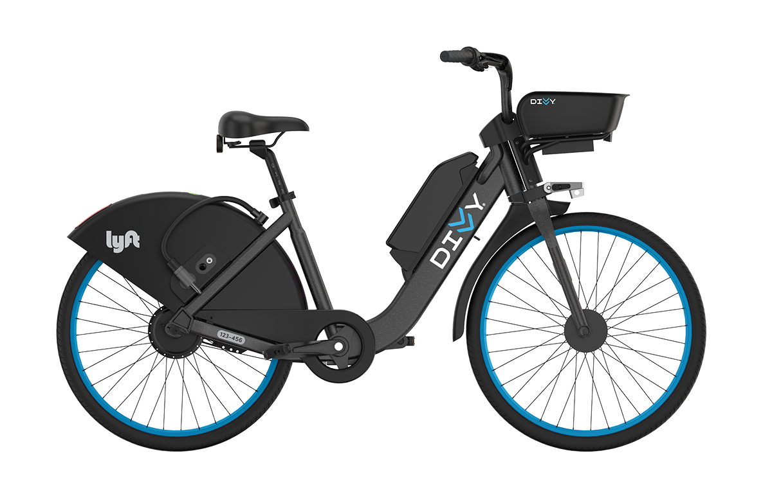
Emerging Trends and Technology
E-Bikes: The number of shared e-bikes on North American streets doubled in 2020 to 30,000 devices. 19% of all bike share trips were taken on e-bikes.
The average distance of e-bike trips is 67% longer than pedal bike trips.
E-scooters: Devices are becoming sturdier and more comfortable. Newer scooters are typically longer and wider, have more comfortable handlebars, and have much larger and air-filled tires.
Sidewalk Riding: Multiple e-scooter vendors have developed sidewalk riding detection technology. Milwaukee is among the first cities to require its use.
Lock-To: Chicago, Minneapolis, San Francisco and Washington DC have all required devices to be locked to a fixed object to end a trip.
Mopeds: Revel now runs shared mopeds in New York, Miami and San Francisco. Lime has begun offering shared mopeds.
E-bikes were the only shared micromobility mode to see an increase in trips in 2020.
Lime's lineage of scooters shows devices becoming sturdier and more comfortable.
Notes:
The explosive growth of e-bikes presents new challenges and opportunities for street design. In fact, e-bikes were the only shared micromobility mode to see an increase in trips in 2020.
E-scooters are becoming stronger devices that can better handle city streets. Has both safety and ridership implications?
New technology has emerged to reduce e-scooters on sidewalks.
Lock-to requirements are better organizing device parking on sidewalks.
Mopeds... micromobility or something different?

Slide 3
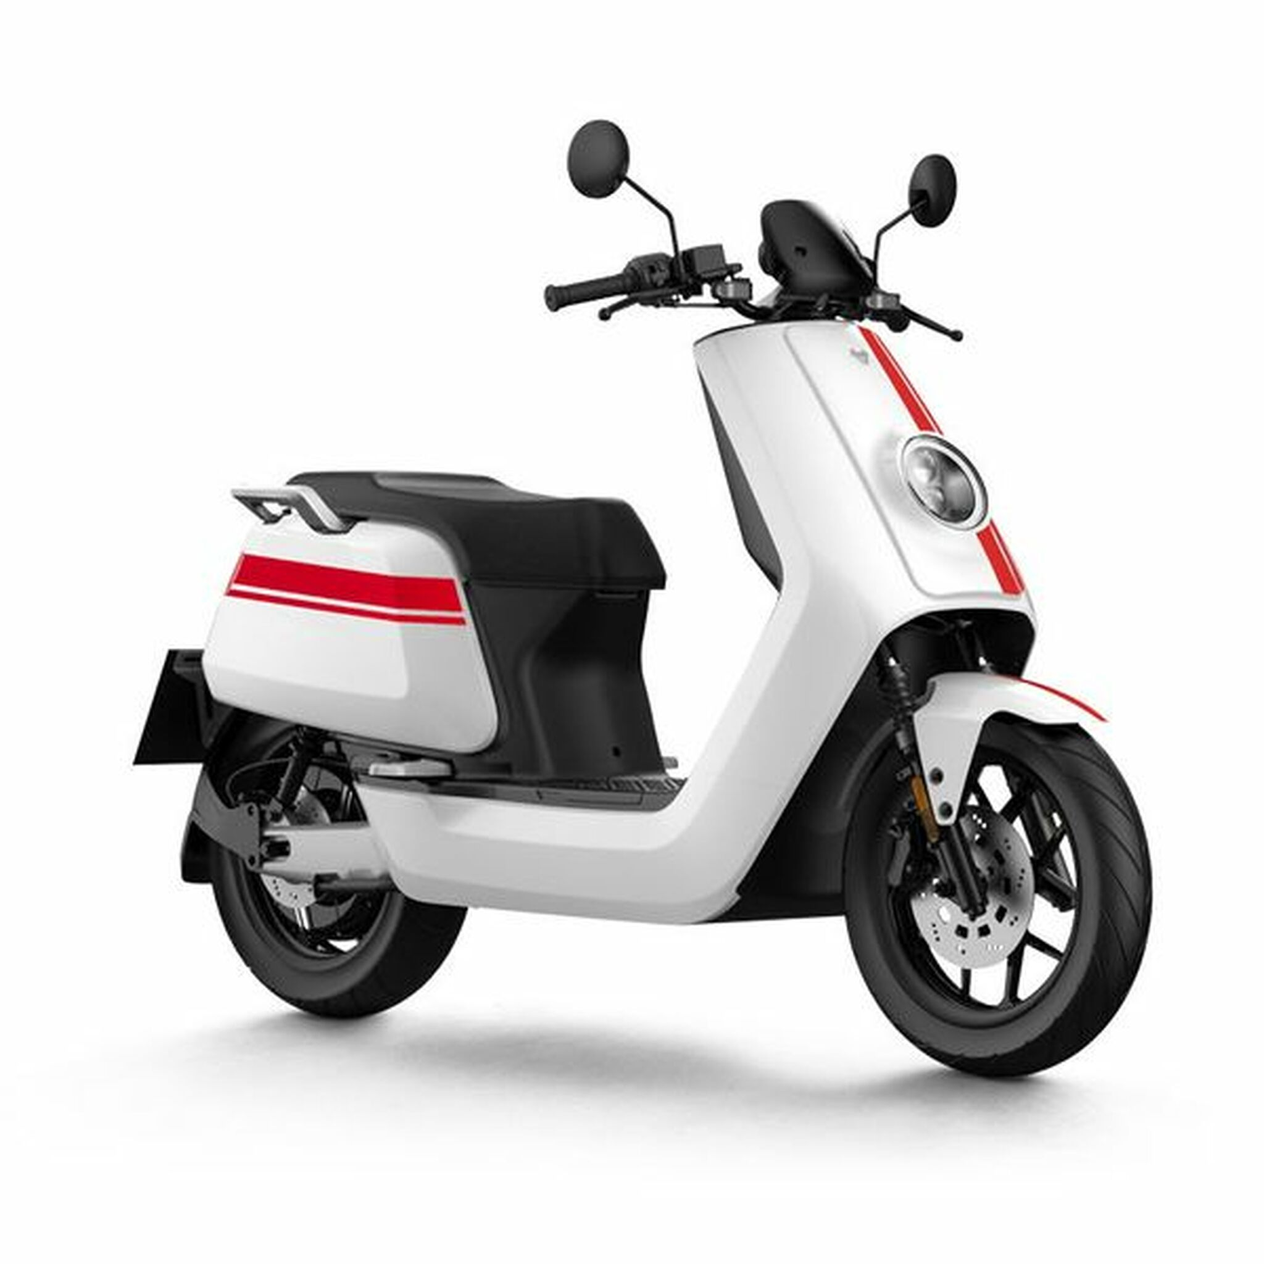
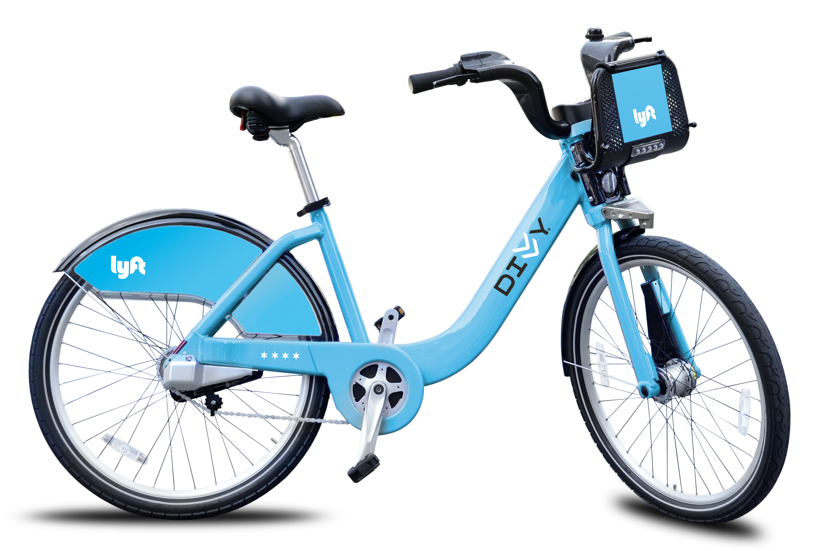
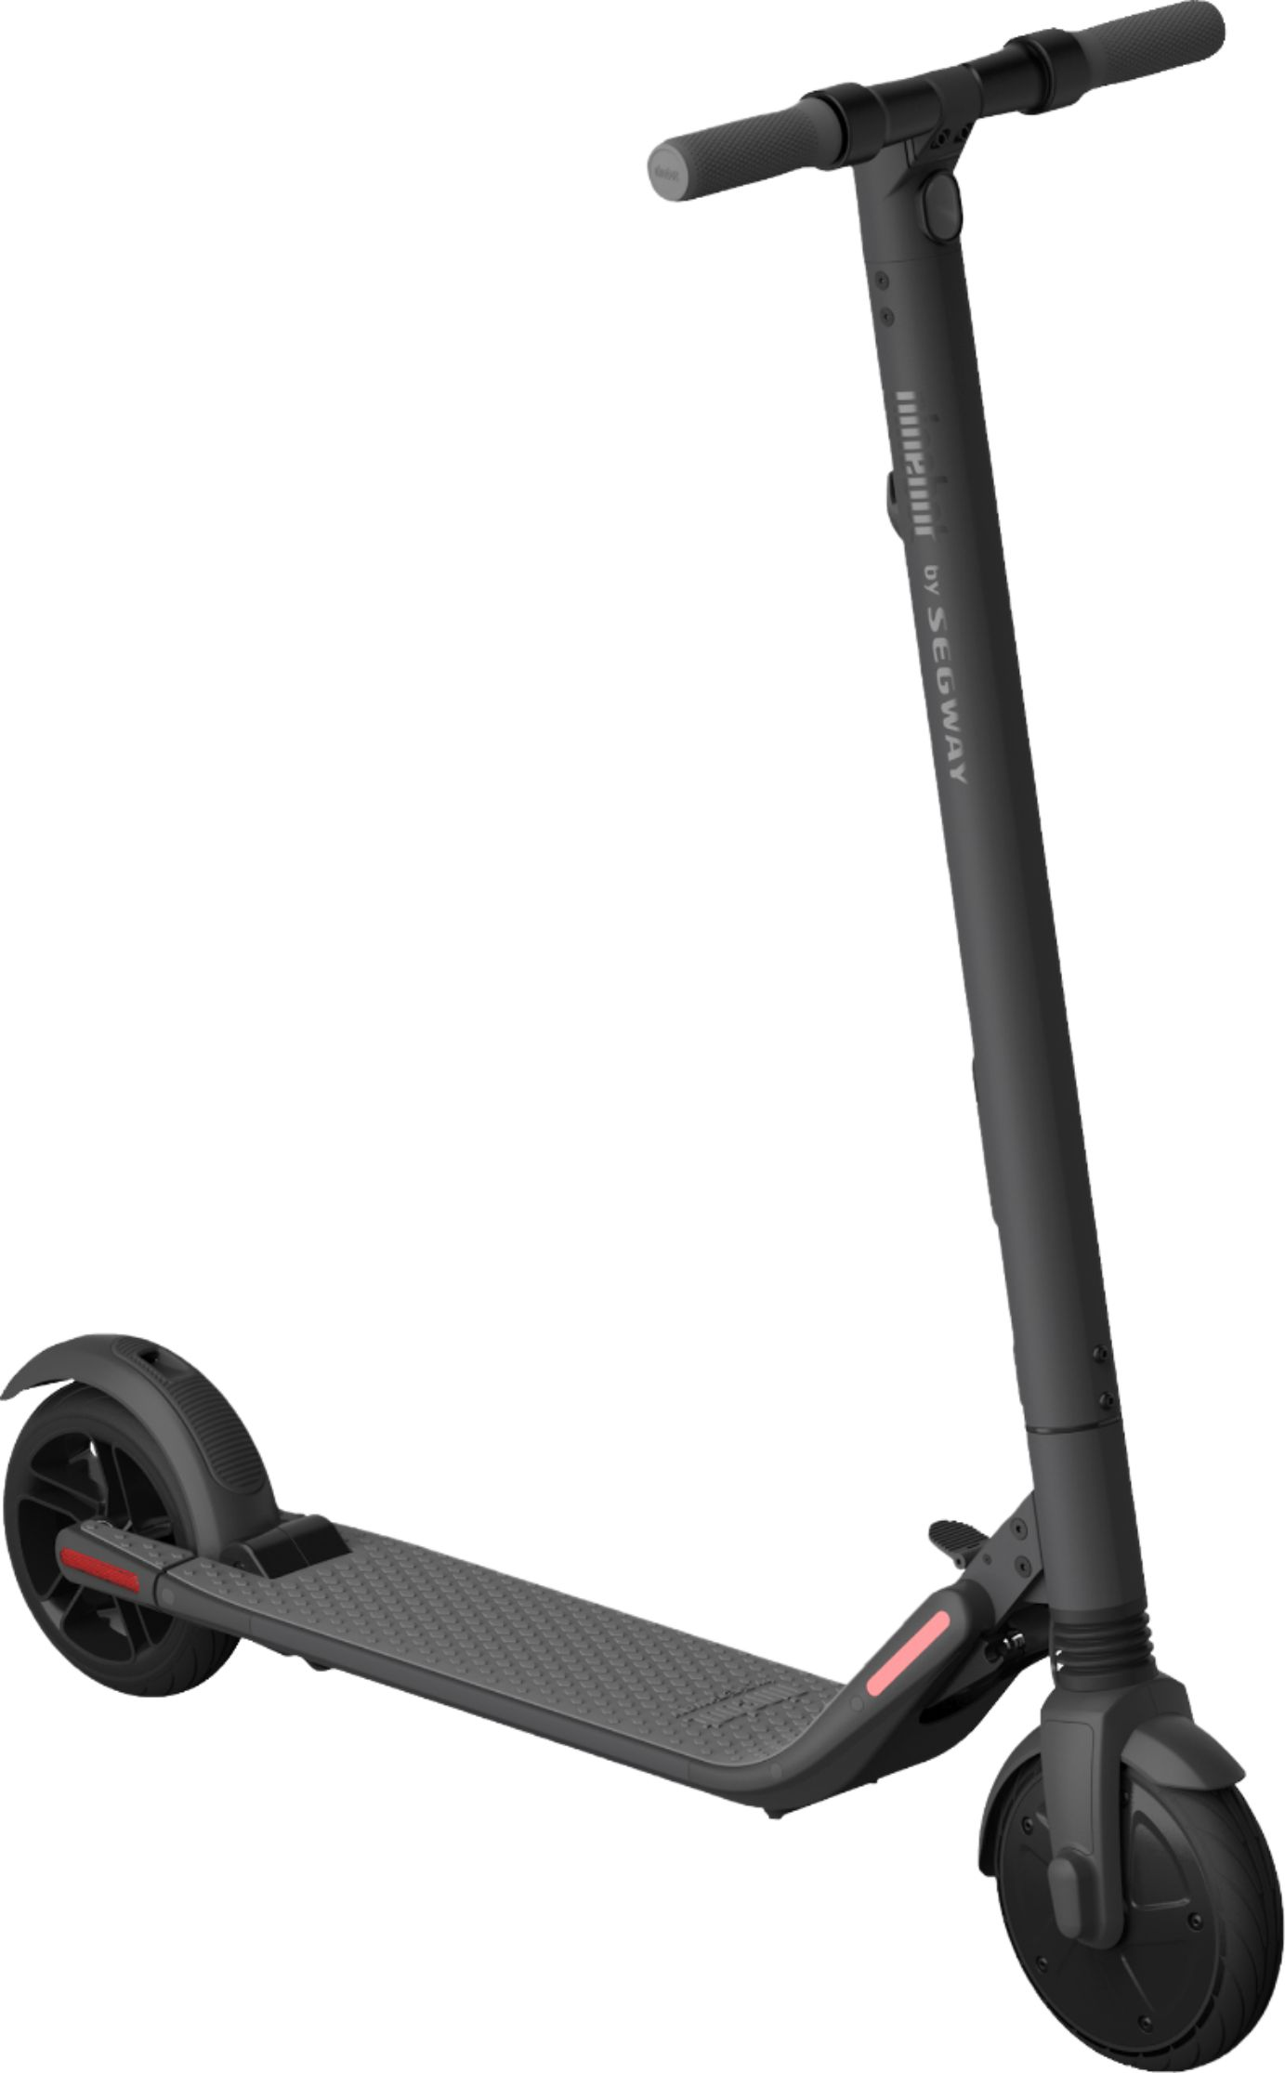
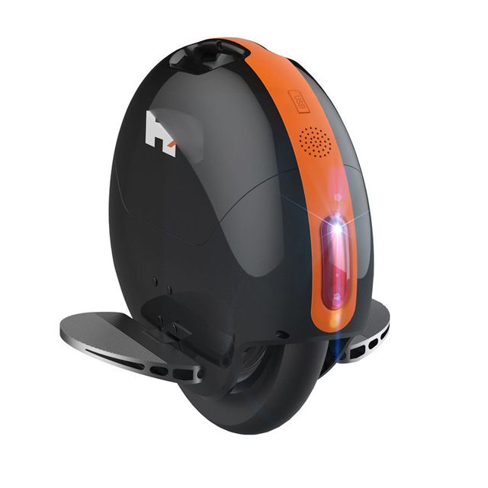
Spectrum of Micromobility
Pedal Bike Electric One-Wheel Electric Scooter Electric/ Electric-Assist Bike
Lower speed
Shorter trip distances
Works well in traditional bike lane
Higher speed
Longer trip distances May present challenges for
traditional bike lanes
Notes:
Micromobility sits on a spectrum. Speed of device influences potential trip distance (and next slide will show influences on-street facility needs).
Electric one-wheels are niche personal devices, but they represent how new tech may continue to enter the market and how we will need these frameworks to more efficiently assess new tech
Mopeds share some qualities of micromobility, but have different operational and parking needs
So overall, can we establish design parameters based on functional characteristics for this full spectrum of mobility devices?

Slide 4
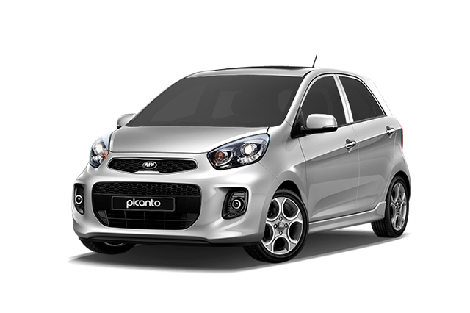
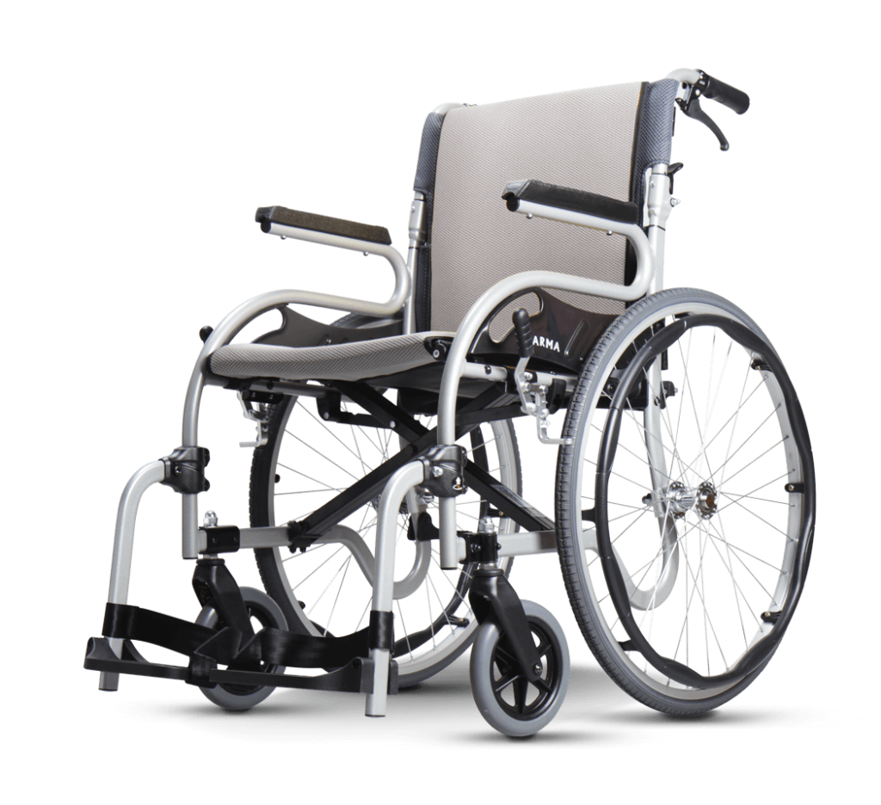
How Should Different Users Be Accommodated on the Street?
Low-speed, low-stress streets
Sidewalk
Roadway
Higher-speed, higher-traffic streets
Sidewalk
Bike/ Micromobility Lane
Roadway
Emerging Issues:
Increased micromobility use will require more bike lanes and wider bike lanes
Wider bike lanes will help accommodate modes moving at different speeds
E-bikes moving faster than 15 mph may be best suited within roadway on moderate speed and/or moderate traffic streets
Mopeds should always use the roadway
Sidewalks and curb parking lanes will need to increasingly accommodate more parked bikes and scooters
Notes:
Infrastructure needs depend on speed, traffic volumes and overall stress of a street.
E-bikes represent a range of speeds, and therefore sit on the edge of being bike lane vehicles and being roadway vehicles.
Wider bike lanes (i.e. “micromobility lanes”) accommodate increased traffic and allow faster devices/operators to pass other users.
Can we establish consistent regulations, design parameters, and design guidance as technologies continue to evolve?
The ITE Micromobility Design Guide can serve as a repository for these practices and support increased consistency across the agency.

Slide 5
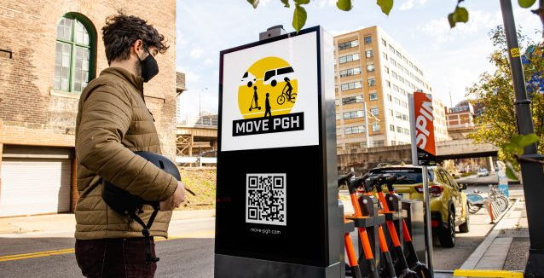
Mobility Hubs and Micromobility
We best improve mobility by integrating shared micromobility into the larger transportation network.
Coming Soon: ITE Mobility Hubs Informational Guide
Mobility Hub Key Features:
The hub should be well-defined, by branding and by spatially co-locating services
Surrounding street and sidewalk design should prioritize space for quick and easy transfers between modes
Walking is part of nearly all multimodal trips, so high-quality pedestrian design is important
Provide real-time transit information, maps and information on accessing each mode
Mobility Hub Potential Services:
Transit station
Bus stop
Bike share/ scooter share
E-bike/ e-scooter charging
Personal bike parking
Bike repair station
Car share
Source: Next Pittsburgh
Notes:
I want to end by making a plug for another upcoming ITE resource: a Mobility Hubs guide being developed through the MaaS/MOD Steering Committee.
Mobility hubs make connections between different modes as seamless as possible by co-locating multiple services.
Mobility hubs should be designed as system, where each node creates a strong network.
Many cities have long co-located mobility services, creating mobility hubs without using that language –
Intentionally building out a network of additional hubs will make this past work even stronger.
The Mobility Hubs Guide will provide higher-level guidance on co-locating micromobility with other transportation modes, micromobility hub design best practices, as well as policy and funding considerations.
Keep an eye out!

